Slide 1
Accent
Business center monitoring system
Dăian George
Ungureanu Florin
29.07.2019
On THE FUTURE

Slide 2

What is BCMS?
Data acquisition
Read data from sensors and send them to a server.
Monitor and Improve
Monitor the environment and improve it using the acquired data.
Statistics
Create statistics based on the collected data.
Security
Protect your company against unauthorized people.

Slide 3







What does a BCMS contains?
Sensors
Single Board Computer
(SBC)
Dashboard

Slide 4
Objective
Create a system that monitors some rooms or offices by gathering data from sensors and capturing photos using a webcam.
Track people’s activity (moment they arrive at work).

Slide 5
SLIDE ARHITECTURA

Slide 6
SLIDE Rpi

Slide 7
SLIDE SENZORI

Slide 8


Communication
Through MQTT(Message Queuing Telemetry Transport)
-> publish-subscribe messaging protocol
-> this pattern requires a message broker
-> information organized in a hierarchy of topics
Two parts
-> RPi: Paho Mqtt
-> Server: M2Mqtt

Slide 9
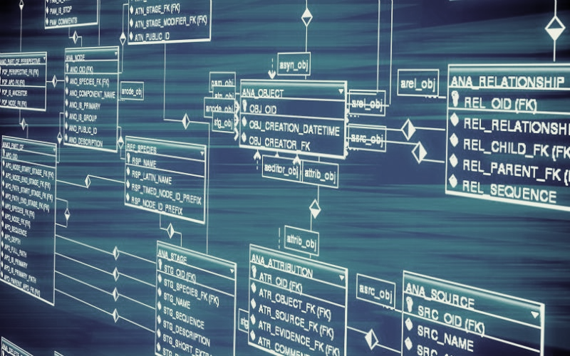

D atabase
-> SQL Server
-> ORM(Object-Relational Mapping) : Entity Framework
-> Tables (ex) : SensorsData, VisitorPhoto
-> BLOB (Binary Large Object) to store images in database

Slide 10











Web Server
Used technologies/programming languages:
-> .NET MVC (C#)
-> Javascript
-> Html
-> Css
-> Bootstrap (Styling)
-> Entity Framework
-> SQL Server
-> M2Mqtt
-> Magic Wand

Slide 11

Version Control
InnerSource (git)
-> place under version control all the resources used
Documentation:
-> document all the tools used (this week)
-> user manual/ readme
Planning:
-> daily stand-up, backlog, sprints, demo

Slide 12
Objective
-> Create a system that monitors some rooms or offices by gathering data from sensors and capturing photos using a webcam
-> The system consists of:
a) Web Server : web page + database
b) IoT : SBC (single board computer) + sensors + connection + data processing

Slide 13

Realize your
presentation title GOES HERE (L1)
Speaker name 1 (Level 3)
Speaker name 2 (Level 3)
Month Day, YEAR (Level 4)
poten
Tial

Slide 14
Welcome to our new template
FONTS
This template is formatted with Arial for seamless use regardless of source or recipient
If you would like to use the version with our branded font, Graphik, download it from Brand Space.
INSPIRATION
Several custom title slide examples follow.
You can select one or more to modify, and delete the remaining examples.
The inspiration is intended for both visuals and content.
Headlines in particular need to be brief to make the most of these designs.
RESOURCES
Usage tips and resources are provided throughout the example slides in this template.
Check Brand Space for dates and times of PPT training.

Slide 15
BIG DEAL
SMALL
PROMISE

Slide 16
DIVIDER OVER GRADIENT

Slide 17
DIVIDER OVER GRADIENT

Slide 18
divider over gradient

Slide 19
divider over gradient

Slide 20
RESOURCES
Grouped (top/bottom) Editable & Scalable Symbol
Editable & Scalable Symbol
Wordmark with Editable Symbol
Preset Gradient Fills (Format Painter)

